Slide 1
In My Own Skin
Sexuality During and After Transition

Slide 2
Julie Miller, LMFT
*Master's in Marriage and Family Therapy from Friends University
*AASECT--training to be Certified Sex Therapist
*McKenzie & Associates
*therapywithjulie.com

Slide 3
Ash Wickell, LMFT
*Master's in Marriage and Family Therapy, Friends University
*LGBTQ Focus
*Trauma-Informed Care
*Identity Development
*Coming Out and Transition
*ashwickell.com

Slide 4
Sex-Positive Framework
"The belief that sex is a healthy force in our lives... It describes a person or group that maintains an optimistic, open-minded, nonjudgemental attitude toward all forms of consensual sexuality." (Easton and Hardy, 2009)
Curiosity
Awareness
Respect

Slide 5
Trans-Positive Framework
Transgender identities exist within the range of normal human variation: they are not intrinsically pathological or disordered
Transgender individuals and communities are the most appropriate source of information on the content and naming of transgender identities
As clinicians, we serve transgender clients most effectively when we take their word for who they are, how they feel, and what they need.

Slide 7
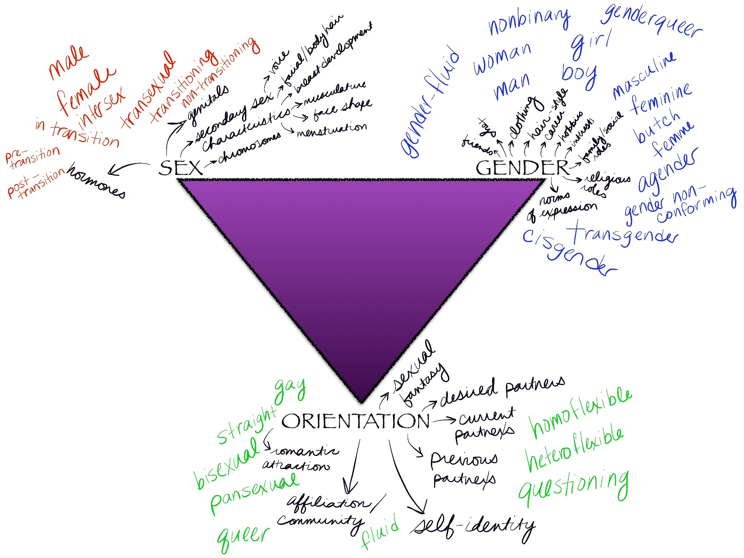

Slide 8
Points of Overlap & Complexity
Research suggestive of sex-related differences in neurobiology of transgender individuals (*citation)
Social norms and sex assignment at birth
Social and emotional impact of unchosen changes to and variations within sex-related physiology
Relational significance of both sex and gender--how do these impact attraction? Identity and sense of self in relationship?

Slide 9
Transgender Etiquette
Affirmation and Inclusion: A Basic Introduction

Slide 10
Encoding Support
Decoding Identity
Challenge and value of the proliferation of identity-related language
Utility of language as signifier of engagement, attention, support
Difficulty of engaging vernaculars and communities that may be unfamiliar, and which are in continuous flux

Slide 11
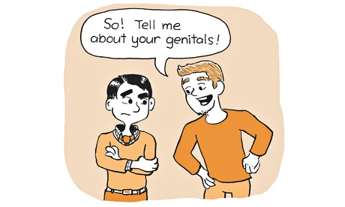
What (Not) to Say
Gendered directionality in identities, pronouns, honorifics, and names
Choice, complexity, client agency
Mindful engagement of anxiety: yours, mine, and ours

Slide 12
Sexuality in Relationship
Connection, Intimacy, and Mindful Self-Awareness

Slide 13
Sexuality: Our Capacity for Sexual Feelings
Problems with Defining Sexuality: -Constantly changing and shifting. -Evolutionary process we get to observe, experience, and share, the more we allow ourselves to engage it with open curiosity.
How might defining sexuality affect curiosity? -The more we define it, the more we limit our awareness of our sexual self. The more fragmented our awareness, the less we share our true selves with others. -Limited Self-Knowledge = Limited Intimacy

Slide 14
Nurturing Sexuality
Acceptance: sexuality as an innate capacity
Balancing our many parts: emphasizing and neglecting our sexual selves
Not simply a PERK!

Slide 15
Intimacy
Knowing who YOU ARE in relationship to another person as you grow and change TOGETHER.
Sharing one's AUTHENTIC SELF with no guarantee of reciprocity.
INTEGRITY: Grace under pressure.

Slide 16
Mindfulness
R: Recognize what is happening.
A: Allow life to be just as it is.
I: Investigate inner experience with kindness.
N: Non-identification.
Wheel of Awareness: Time to Practice!

Slide 17
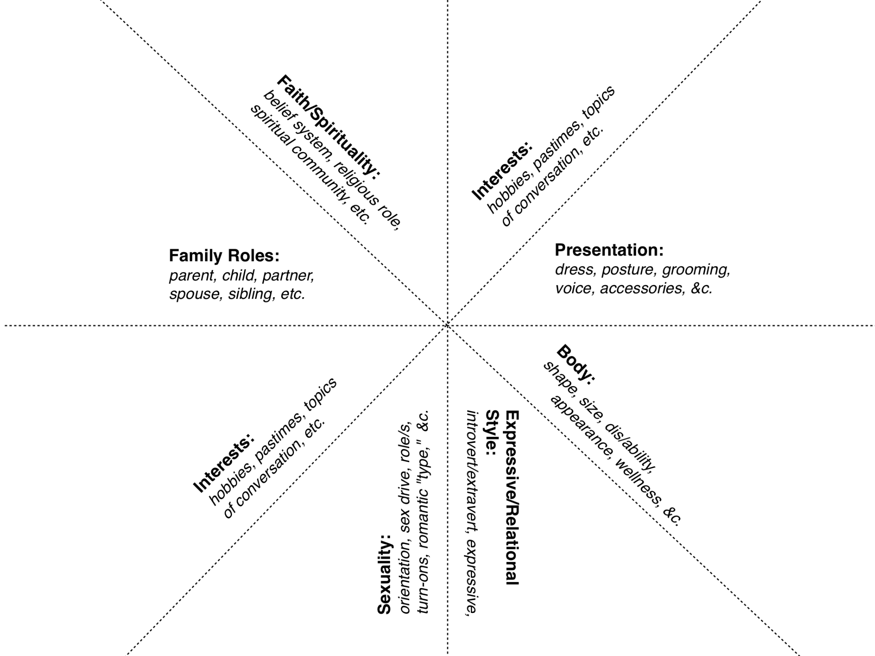

Slide 18
Trans-Specific Considerations in Treatment

Slide 19
Transition-Related Developmental Tasks
Models of identity development: utility, critiques; stage-oriented vs. process-oriented
Normative gendered development, as contextualized by transgender erasure and oppression
Sexual exploration and identity formation among transgender clients

Slide 20
Trans Identities in Relationship
Together and separate: balancing shared and opposed identities (sex-gender-orientation)
Inclusion and address of multiple developmental stages, experienced simultaneously
Social and familial perceptions, and relational transition

Slide 21
Medical Interventions
Shifts in self-perception and embodiment: pre-, during, and post-transition.
Physiological impacts of feminizing hormones and surgeries.
Physiological impacts of masculinizing hormones and surgeries.

Slide 22
Treatment Approach
Assessment: Sexual History/Genogram
Solution-Focused: Constant Change, Identifying Exceptions
Crucible: Integrity, Intentional Choices, Grace Under Pressure
Mindfulness: Awareness, Integration, Emotion, Regulation, Sensate Focus

Slide 23
Mindful Self-Awareness
How do you know what you want?

Slide 24
Integrating Trans Awareness in Assessment and Dx
Openness: Not-Knowing Stance
Flexibility: Being a Therapist vs. Being a Human
Specificity: It's ok (and necessary!) to ask
For clients: Whose body is it? Whose experience is it? Whose relationship/relational history is it?

Slide 25
Models of Explicit Consent
"What can I touch, and what do you call it?" (Bergman, 2006)

Slide 26
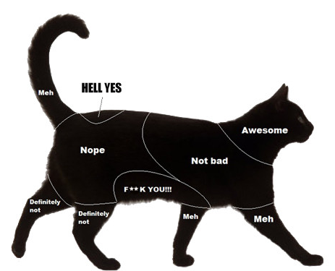
Mapping Consent
Default Maps of Consent: bikinis & baseball
Re-Mapping Consent
What happens when the map changes?
"A map drawn by able nonsurvivors doesn't take into account triggers or nerve conditions. A map drawn by cis people fails utterly to predict what kinds of gendered touch (which is all touch, sexual or not) a trans person will want or accept." (Troost, 2008)

Slide 27
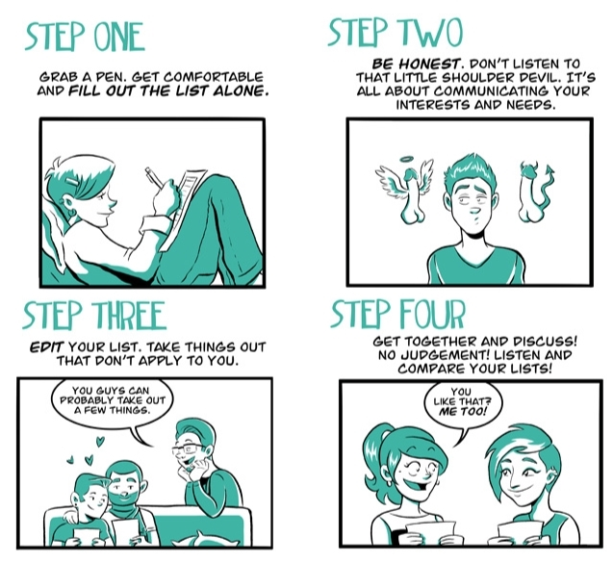
Will/Won't/Want: Introducing Explicit Sexual Communication
Shift away from default consent maps, toward a customizable model of sexual intimacy
Creates space for trans-specific and transition-specific needs and desires
Opens conversation for both partners relative to what is *desired*, as opposed to what is *tolerated*
Saying yes, instead of not saying no

Slide 28
Works Referenced
Easton, D. and Hardy, J. (2008) The Ethical Slut.
Bergman, S. B. (2006) Butch Is A Noun. San Francisco, CA: Suspect Thoughts Press.
Troost, H. (2008) Reclaiming Touch: Rape Culture, Explicit Verbal Consent, and Body Soveriegnty. In Friedman, J. and Valenti, J. (ed.) Yes Means Yes (pp. 171-178). Berkeley, CA: Seal Press.
Blas, T. (2012, August 5). Sex List. Retrieved from http://www.ohjoysextoy.com/sexlist/

Slide 29
Additional Resources
World Professional Association for Transgender Health: www.wpath.org
National Center for Transgender Equality: www.nctequality.org
American Association of Sexuality Educators, Counselors, and Therapists: www.aasect.org

